Slide 1
Applied canine cancer and comparative genetics
“Enhancing the dog as a model for human cancers: from genome sequence towards clinical trials”

Slide 2
AIM
Better understanding of disease progression
Background
No good way of tracking disease progression without macroscopic disease
No good medical intervention so
Vi ved ikke en skid vi vil gerne vide en skid
Metoder vi bruger liq, t/n og digi pcr

Slide 3
Background
Diagnostic techniques
Histopathology
Subjective
Morphologic diagnosis
Tumor heterogeneity
Invasive
Immunohistochemistry
Limited no. of markers
Only in conjunction with histopathology
Notes:
What’s wrong with histopathology??
Subjective 10% complete disagreement between pathologists in 1 study!
Can be wrong, fex. Recently got a histopathology report with plasma cell tumor as the diagnosis, was diagnosed as melanoma on cytology, immunhistologial showed melanoma
Cannot necessarily distinguish between different types of cancer fex small cell lymphoma and mantle cell lymphoma
Tissue can be hard to reach/invasive to get or can be dangerous to extract, fex splenic tumor and a low thrombocyte count.
Even with ihc limited information is available
In theory possible to diagnose on a blood sample
Dogs as a model has the advantage of low genetic diversity like rodent models, but the cancers still occur spontaneously

Slide 4
Background
Diagnostic techniques
Histopathology
Subjective
Morphologic diagnosis
Tumor heterogeneity
Invasive
“Can’t you just take a blood sample and tell me if my dog has cancer??”
Notes:
What’s wrong with histopathology??
Subjective
Can be wrong, fex. Recently got a histopathology report with plasma cell tumor as the diagnosis, was diagnosed as melanoma on cytology, immunhistologial showed melanoma
Cannot necessarily distinguish between different types of cancer fex small cell lymphoma and mantle cell lymphoma
Tissue can be hard to reach/invasive to get or can be dangerous to extract, fex splenic tumor and a low thrombocyte count.
In theory possible to diagnose on a blood sample
Dogs as a model has the advantage of low genetic diversity like rodent models, but the cancers still occur spontaneously

Slide 5
Background
Diagnostic techniques
Histopathology
Subjective
Morphologic diagnosis
Tumor heterogeneity
Invasive
“Can’t you just take a blood sample and tell me if my dog has cancer??”
We are working on it!
Cytogenetics
Less invasive
Earlier detection (liquid biopsies)
Notes:
What’s wrong with histopathology??
Subjective
Can be wrong, fex. Recently got a histopathology report with plasma cell tumor as the diagnosis, was diagnosed as melanoma on cytology, immunhistologial showed melanoma
Cannot necessarily distinguish between different types of cancer fex small cell lymphoma and mantle cell lymphoma
Tissue can be hard to reach/invasive to get or can be dangerous to extract, fex splenic tumor and a low thrombocyte count.
In theory possible to diagnose on a blood sample
Dogs as a model has the advantage of low genetic diversity like rodent models, but the cancers still occur spontaneously

Slide 6
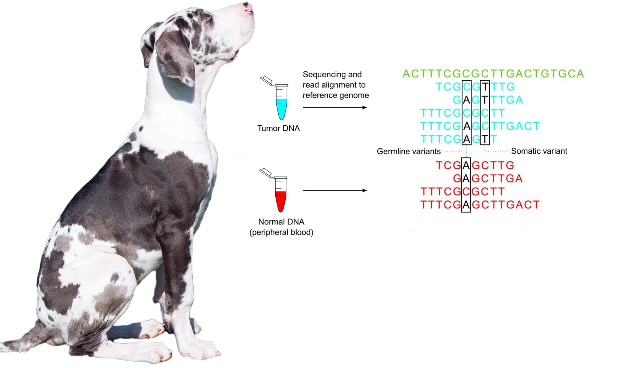
Analysis
Tumor/normal data
To account for genetic variation between individuals, each individual is used as its own control
Blood is often used as control tissue
Edited from publicdomainpictures and http://clinchem.aaccjnls.org/content/59/1/127
Notes:
Mammary tissue can’t be a control as most of it is changed in some way (hyperplasia ≠ good control)
Digital PCR builds on traditional PCR amplification and fluorescent-probe–based detection methods to provide highly sensitive absolute quantification of nucleic acids

Slide 7
Evaluation of ERBB2 Copy Number Variation in canine mammary tumors
Aim
To evaluate whether some canine mammary tumors (CMT) contain ERBB2 amplification like some breast cancers in humans.
Research questions:
Is there amplification of the ERBB2 gene in certain subtypes of CMT?
Is amplification prognostic in CMT
Can droplet digital PCR accurately estimate copy number variation?
Are there any similarities to HER2+ breast cancer?
Notes:
Background
Proto-oncogene stimulating proliferation
Some types of breast cancer in humans have overexpression of HER2
Associated with worse outcome
Is a potential drug target and amplification of the gene is prognostic.
Her2= ligner human epidermal growth factor receptor1 Ingen kendte ligander.
Proto-oncogene som promoter proliferation og modvirker apoptotiske pathways via forskellige proteinkinase pathvej
Important role for development and progression of certain types of breast cancer.
Is a target for therapy in humans -> directly relvant for development of treatment in humans with monoclonal antibodies(trastuzumab and Pertuzumab)

Slide 8
Evaluation of ERBB2 Copy Number Variation in canine mammary tumors
Methods
Design a CNV assay targeting the canine ERRB2 gene
Extraction of DNA from liquid biopsies and mammary tumors
Digital PCR on DNA samples
Estimate the copy number in paired tumor/normal (t/n) samples from 60 individuals with CMT
Evaluation of ERRB2 CNV in 60 paired t/n samples and comparison with histopathology
Notes:
Work will be done in Uppsala
Samples already collected
We’re looking for

Slide 9
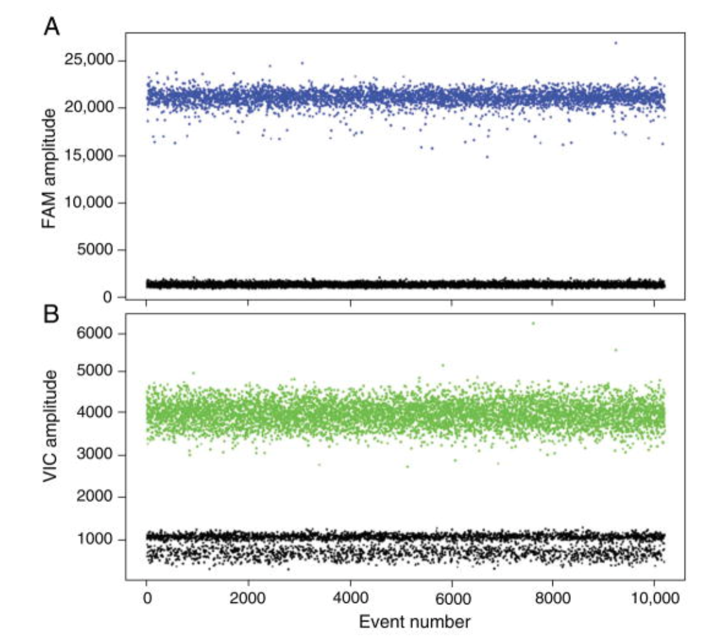
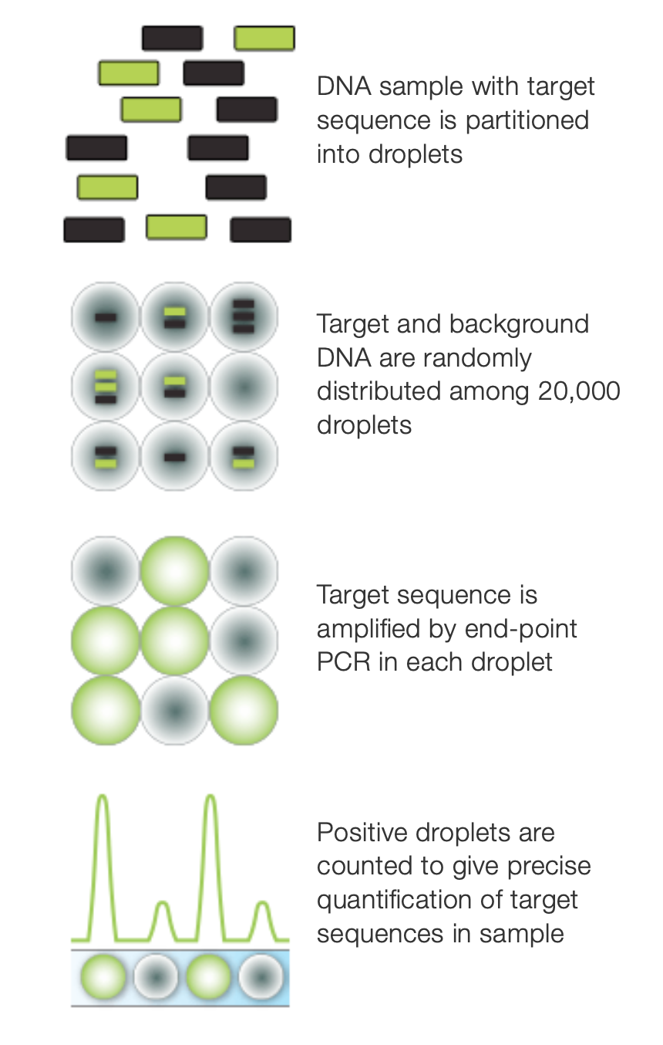
Droplet digital PCR for CNV
Sensitive PCR method
1 molecule per well
2 fluorescent probes
Baseline gene with a known CN
Target gene with unknown CN
Difference in fluorescence amplitude show CN difference
Digital Droplet PCR: CNV Analysis and Other Applications Erica Mazaika et al. 2014
http://www.bio-rad.com/en-dk/category/digital-pcr?ID=M9HE2R15
Notes:
Mammary tissue can’t be a control as most of it is changed in some way (hyperplasia ≠ good control)
Digital PCR builds on traditional PCR amplification and fluorescent-probe–based detection methods to provide highly sensitive absolute quantification of nucleic acids

Slide 10
Identification of somatic variants and correlation with tumor characteristics
Aim
Investigate mutational patterns in CMT, osteosarcoma (OSA), and lymphoma (LSA) and the relationship with tumor stage, grade, and clinical outcome
Research questions:
Can CMT, OSA, and LSA be subtyped based on their mutation patterns?
Do the subtypes have clinical significance?
Is tumor stage reflected in the mutational profile for each tumor type.
Notes:
F.eks. OSAs often have p53 mutations, do these cases have a worse outcome?
Can we say that dogs with x mutation won’t benefit from some (or any) interventions?
Possible drug targets. F.eks. All simple carcinomas or a specific subset of t-cell lymphomas have KIT mutations, then Masitinib might be beneficial.
Nonsense mutations: stop codon fex ‘TAA’ so you have a point mutation in TAC (tyrosin) ->TAA: Translation is stopped = nonfunctioning protein
Startcodon=AUG
If mutations are known, then possible drug targets are known
Masivet for KIT+ mct
Can we say that specific mutations is correlated with better or worse outcome? F.ex. Is outcome worse with a tp53 mutation which is a common mutation in osa.
If tumor stage is correlated with mutations, then it would be possible to stage without doing a full body ct.
Breast cancer very prevalent disease, treatment has gotten better, but still high mortality. Affect 2.1 million women/year ~627.000 died in 2018, around 15% of cancer deaths among women.
High mortality of both LSA and OSA. More common in dogs, easier to investigate. Unknown which subtypes of LSA dogs are good models for.
Also, does it compare to people

Slide 11
Identification of somatic variants and correlation with tumor characteristics
Methods
Collection of t/n samples
Exome sequencing of 40 t/n samples each year
Classify tumors based on their mutational landscape
Correlate clinical parameters to mutational signatures
Compare to equivalent human cancers

Slide 12
Liquid biopsies
Theory
Tumors release circulating tumor DNA (ctDNA) to the blood
This DNA can be used to detect disease
Minimal residual disease
Recurrence
Advantages
Less invasive
Easy to follow disease progression
Screening for cancers
Notes:
All blood contain free circulating DNA, released from cells dying (necrosis, apoptosis, trauma etc.)
Serious issues as of now for screening. Overdiagnosis, but if only used for patients with known risk factors. Done with ctCells in COPD patients in relation to developing lung cancer
Levels after intent-to-cure surgery correlates with relapse, if ctDNA found after surgery -> bad prognosis -> consider adjuvant therapy
Can be used before macroscopic disease occurs in case of relapse -> consider adjuvant therapy.
Levels of ctDNA also predictive for worse outcome

Slide 13
Identification of somatic mutations for diagnosis, monitoring disease relapse, and progression
Aim
Investigate levels of circulating tumor DNA (ctDNA) in dogs with high grade mammary tumors
Study tumor evolution
Research questions
Can ctDNA from the tumors be identified in the cell-free DNA fraction?
Are the levels of ctDNA stable over time?
What kind of mutations are observed over time? Evolution of these?
Notes:
Treatment = curative intent surgery

Slide 14
Identification of somatic mutations for diagnosis, monitoring disease relapse, and progression
Methods
Extraction of cfDNA from liquid biopsies
Quantify levels of ctDNA in cfDNA
Identify somatic mutations in liquid biopsies
Repeated collection of liquid biopsies
Study tumor evolution over a 2 year period
Notes:
If >10% of cfDNA -> whole exome sequencing
Repeated clinical follow-up with collection of liquid biopsies
Sampling ever 2nd months the first year, then every 6 months (8 visits in total).

Slide 15
Patient requirements
Identification of somatic variants
Canine patients with
Mammary tumors
Lymphoma
Osteosarcoma
Identification of somatic mutations in cfDNA
Canine patients with
High-grade mammary tumors
Recruitment starts in ~April!
Notes:
Canine patients with mammary tumors, multicentric lymphoma, or osteosarcoma
One time sampling
Canine patients with mammary tumors
Must tolerate vet visits well
Sampling at surgery
Follow-up:
Every 2nd month for 1 year
Twice a year for 1 year
Risk factors for poor outcome
Ulceration unrelated to trauma
Large size
High growth rate

